Slide 1

The 2+2 Programme
Yikuo Liu

Slide 2
Who am I
刘译阔
(Yikuo Liu)
09/2010 – 07/2012 B.Sc. Geophysics (First & second year), China University of Petroleum
09/2012 – 07/2014 B.Sc. Geophysics (Junior & Senior year), The University of Edinburgh
Graduate Classification: First Class Honours (71.4%)
10/2014 – 09/2015 M.Sc. Petroleum Geophysics, Imperial College London
Graduate Classification: Distinction (78.1%)
09/2016 – present Ph.D. student, The University of Edinburgh
Research interests: numerical modelling of electromagnetic waves; geophysical inversion
Contact: email: yikuoliu@hotmail.com
wechat ID: lyk1061334708

Slide 3
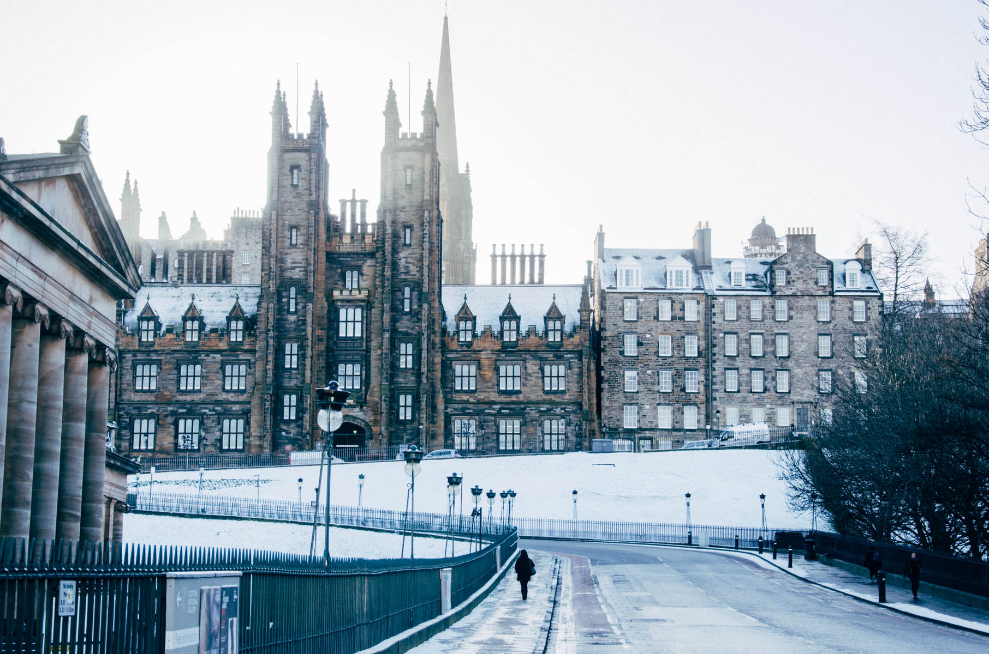
Why 2+2
“Destiny is not a matter of chance; it is a matter of choice.” – William Jennings Bryan

Slide 4

Why Edinburgh
“It fills me with great pride to say, I am from the University of Edinburgh.” – Ian Conn

Slide 5
My two years in Edinburgh
Junior Year
2012.08
2012.09
2012.10
2012.11
2012.12
Arrived in Edinburgh
Language lessons
Edinburgh Art Festival
Start the first semester
Mid-autumn festival in UK
First report assessed as 57%
Second report assessed as 55%
Halloween!
Study … (5 or 6 assessments + revision)
Third report assessed as 83%
Christmas!
Final exams
Back to China
Start the second semester
Top marks in the final so celebrate!
Chinese New Year!
Blackpool for roller coaster!
Don’t remember … (lectures I guess)
Easter holiday
Fieldtrip in Scottish Highlands
Seismic interpretation project
Revision
Final exams
Hiking in Edinburgh
Enjoy the summer
Back to China
2013.1
2013.2
2013.3
2013.4
2013.5

Slide 6
My two years in Edinburgh
Senior Year
2013.09
2013.10
2013.11
2013.12
Arrived in Edinburgh
Choose the topic of individual project
Fieldtrip in Germany (and a drinking competition!)
PS and CV for master application
Individual research project
Application for master’s study
Thesis writing
Christmas!
Final exams
Back to China
First thesis submitted (and published one year later)
Conditional offer from Imperial College
Start the second research project
Chinese New Year!
Lectures & research
If You Are the One
Eason Chan London Concert 2014
Thesis writing
Second thesis submitted
Easter holiday (a revision holiday)
Final exams
Enjoy the summer
Back to China
Graduation ceremony
2014.1
2014.2
2014.3
2014.4
2014.5
2014.7

Slide 7
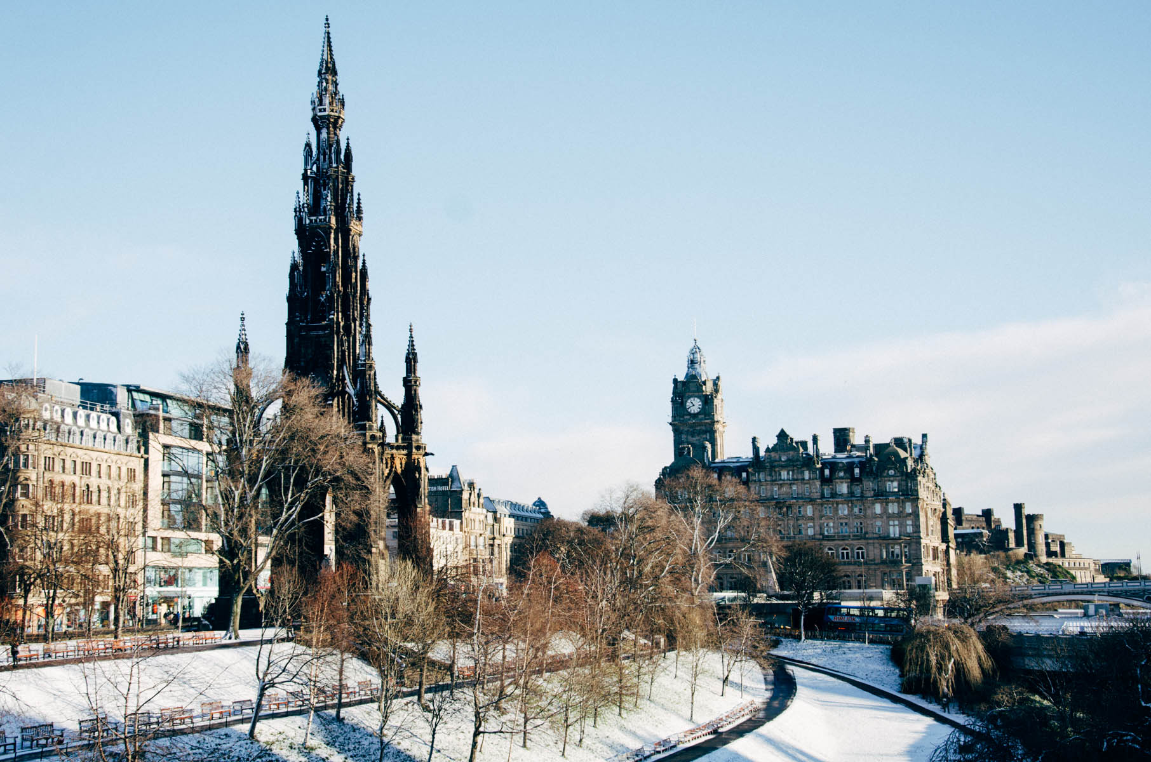
Study
“Do not follow where the path may lead.
Go instead where there is no path and leave a trail.” ― Ralph Waldo Emerson

Slide 8
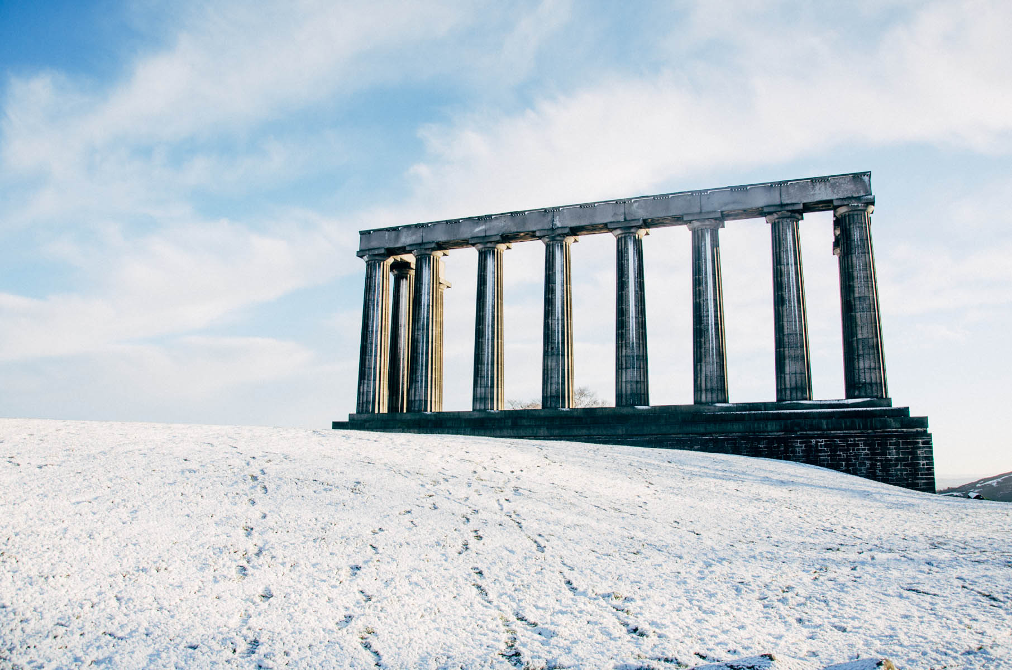
Assessment
“Don't be angry, Finnula had said, be smart.” ― Sarah J. Maas

Slide 9
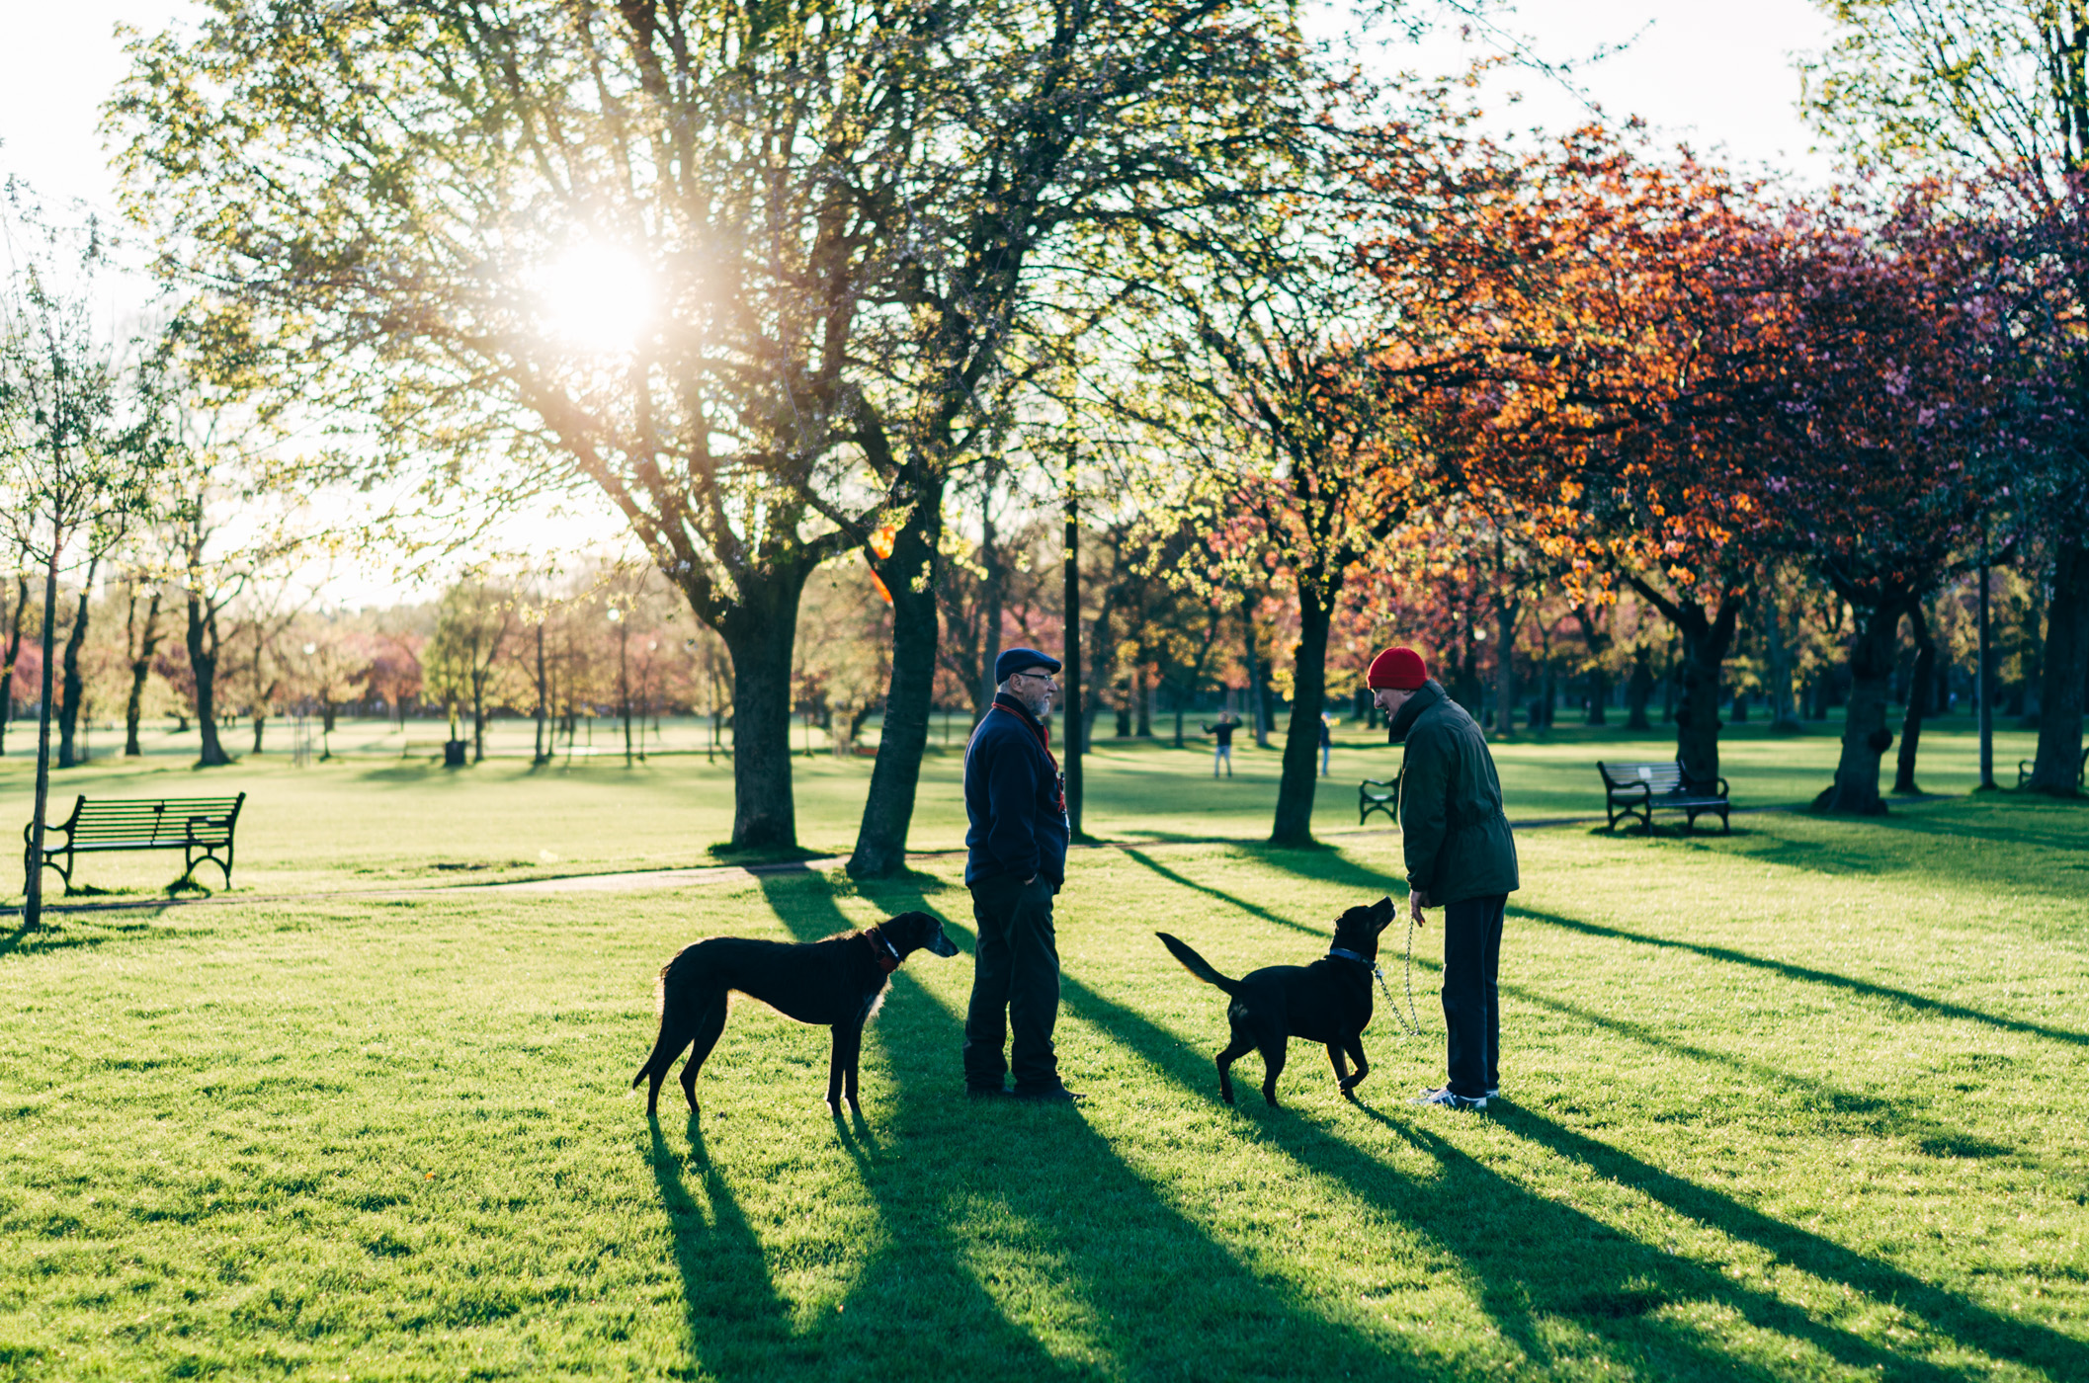
Language
“Anyone can speak Troll. All you have to do is point and grunt.” – J.K. Rowling

Slide 10
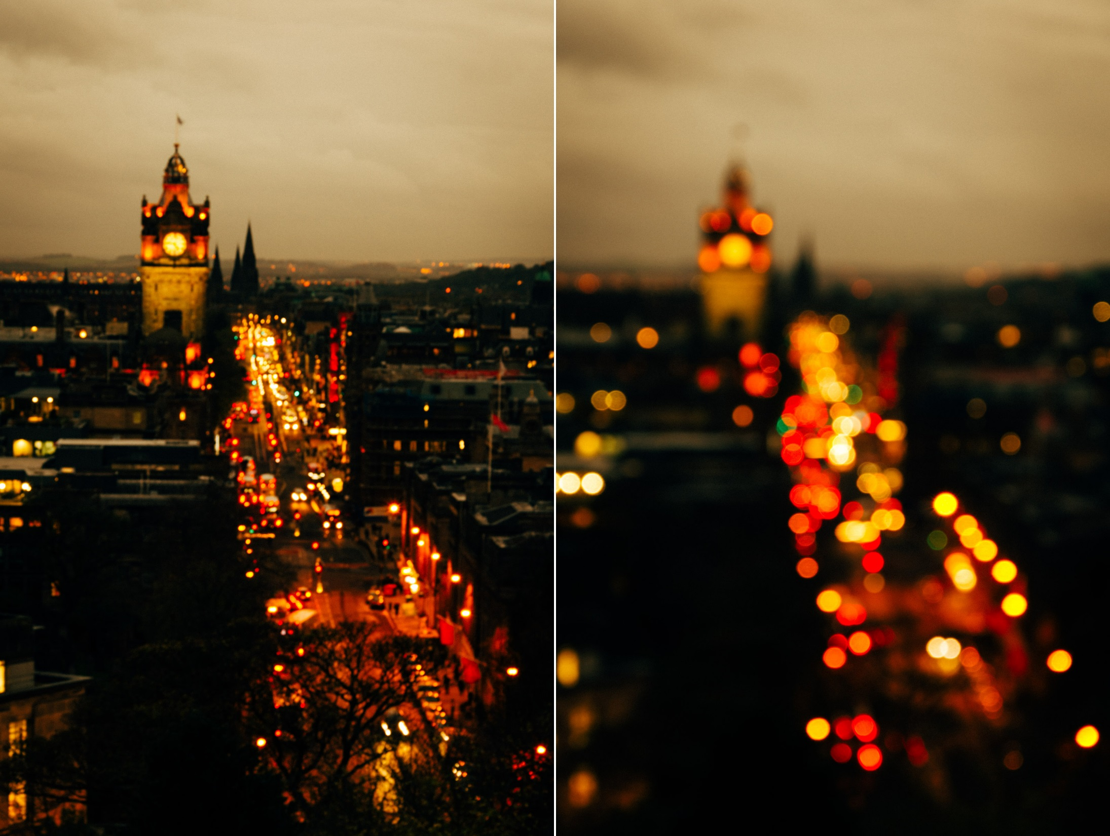
Life
“Work hard, play hard.” – someone said this is the key to life

Slide 11
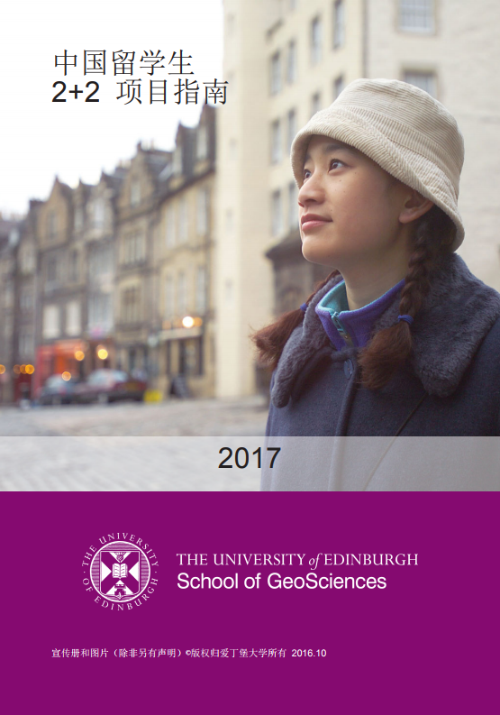
Useful documents & websites
Official guide
https://www.ed.ac.uk/files/atoms/files/22_brochure_mandarin_2017_kb.pdf
Interviews & videos
https://www.ed.ac.uk/geosciences/undergraduate/visiting-students-information/intl-programmes-earth-sciences/videos
https://www.dropbox.com/s/980bkdc2li1l6uz/GeoSciences_mand.mp4?dl=0
Useful websites
https://www.google.co.uk/
https://www.youtube.com/
https://www.myed.ed.ac.uk/

Slide 12
Acknowledgement
I want to thank Li Yang and his studio Lee Young Photography for generously sharing all the photographs about Edinburgh.

Slide 13
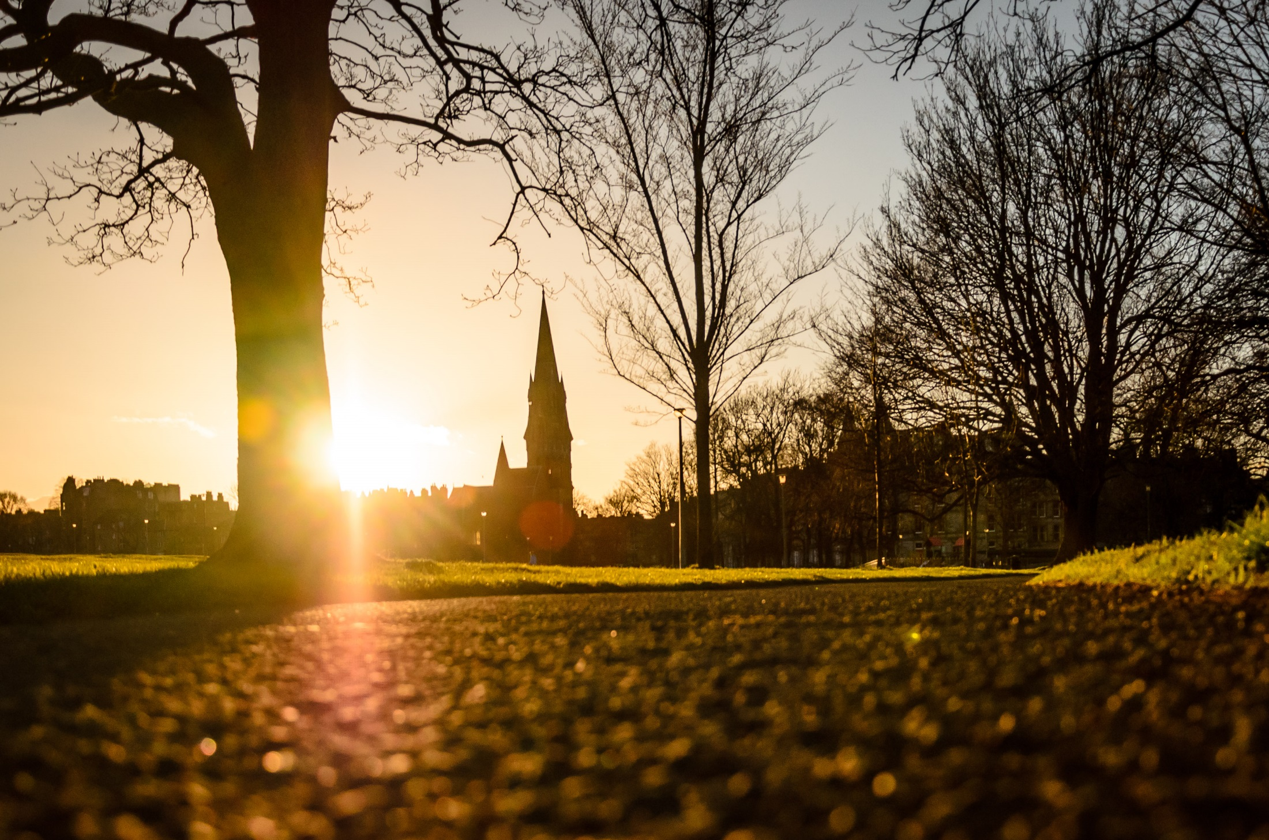
Questions?
Thanks for your time!

