Slide 1


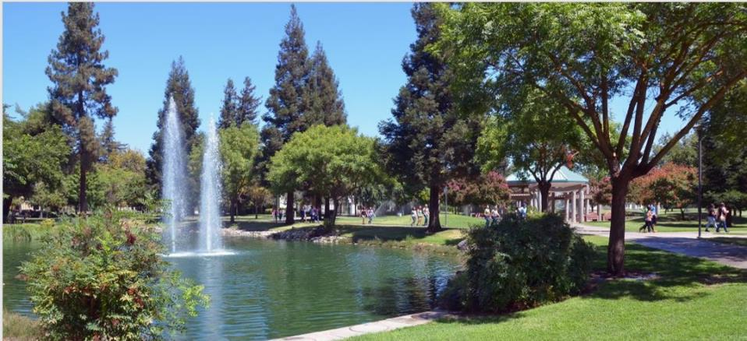
California State University, Stanislaus

Slide 2
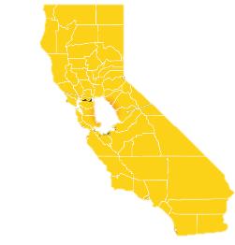



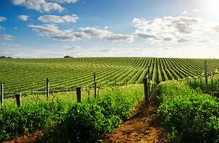
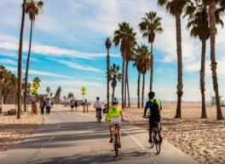
Where is Stanislaus State?
Lake Tahoe
Sacramento
Yosemite
National Park
San Francisco
Santa Cruz
Monterey
Los Angeles
San Diego

Slide 3
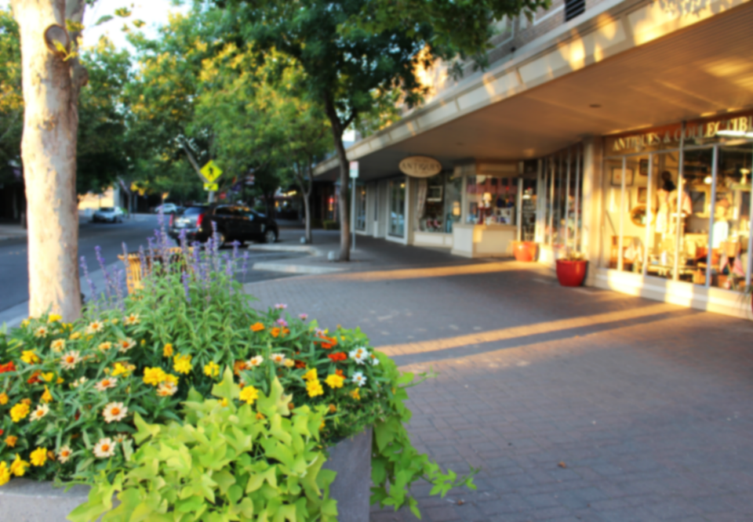
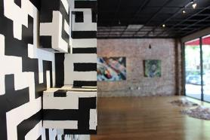

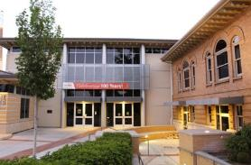
Turlock,
Home of Stanislaus State
We are located in the heart of the Central Valley in the city of Turlock.
Roots in agriculture
Local farmers markets
Diverse, student-friendly community
Lively downtown
Trendy local restaurants
Student Art Space on Main Street
Local Café
Carnegie Arts Center

Slide 4
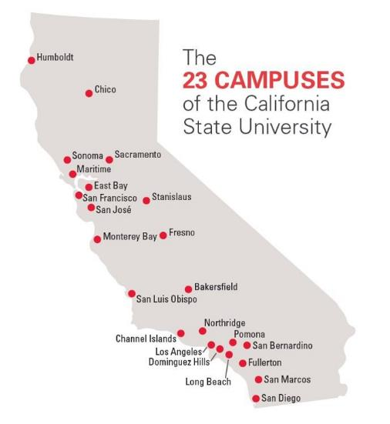

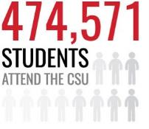
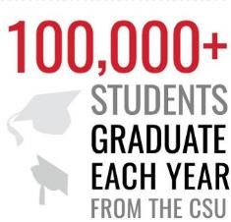

Slide 5



Higher Education in California
California
Community Colleges
Purpose:
Largest higher education system in U.S.
Enrolls over 2.1 million students at 113 colleges
Awards certificates & 2-year associate degrees
Prepares students for technical trades or transfer to universities (CSUs and UCs)
CSU system
Purpose:
Largest university system in U.S.
Educates approximately 474,600 students at 23 campuses
Focused on undergraduate and graduate instruction
Practical education prepares students for careers
UC system
Purpose:
State’s primary academic research institutions
Primary awarder of doctoral & professional degrees
Educates 250,000 undergraduate and graduate students at 10 campuses

Slide 6
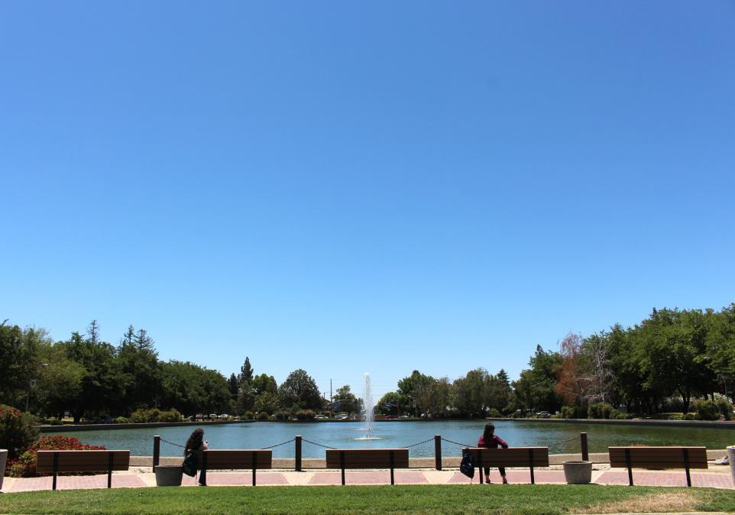
Why Stanislaus State?
Safe & Affordable
Central location
You are not just a number
Space available in every program
22:1
100+
STUDENT ORGANIZATIONS
STUDENT TO FACUTY RATIO
MAJORS, MINORS & CONCENTRATIONS
60+

Slide 7





2015 ranked No. 89 in the western region by Forbes.com
2014 ranked 28th out of 2,500 colleges and universities by TIME Magazine
2014 ranked No. 173th out of 1,500 school nationwide by Money Magazine
10th out of 539 universities across the nation in the Social Mobility Index
Stan State makes Princeton Review’s Top Colleges list for 9-straight year

Slide 8
Cost
Approximate Undergraduate Tuition for Academic Year 2016-17
University of California, Berkeley $43,168
University of Massachusetts $32,343
Pennsylvania State University $31,346
Arizona State University $26,470
Stanislaus State $16,008

Slide 9

Student Services
Academic Success Center
Faculty Mentor Program
Psychological Counseling Services
Tutoring & Writing Center
Career Services
Disability Resource Services

Slide 10
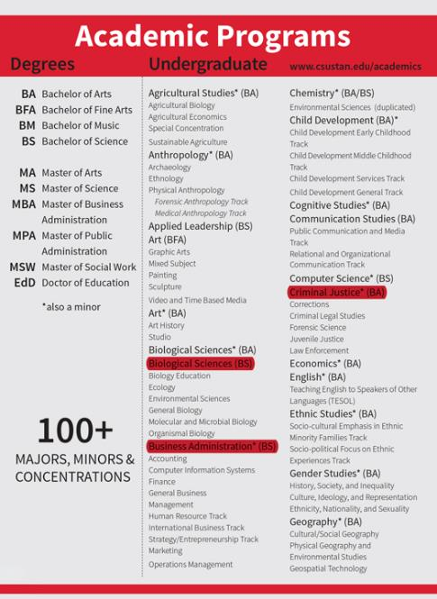
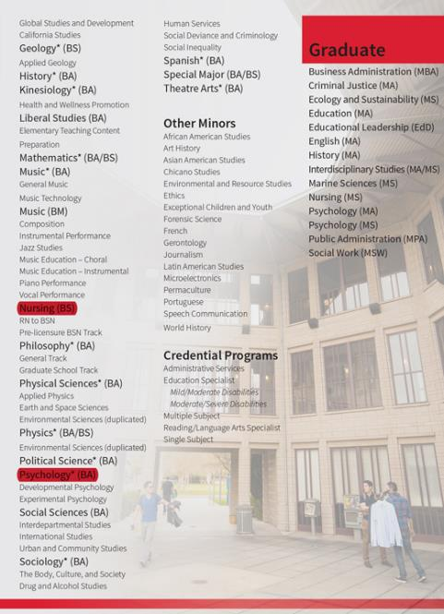

Slide 11
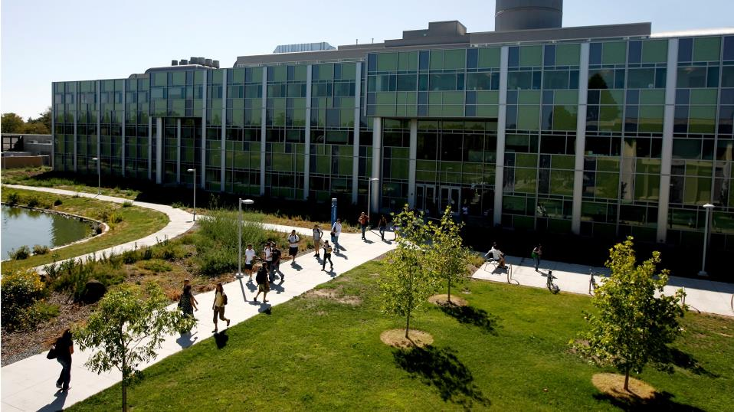
Popular Programs
Agricultural Business/Studies
Business Administration
Cognitive Studies
Computer Science
English
Fine Arts
Mathematics
Psychology
STEM

Slide 12
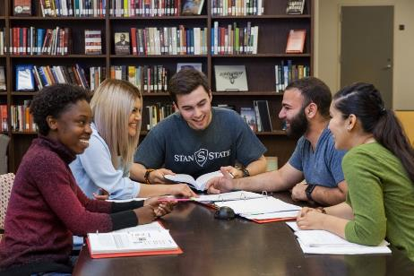

College of Business Administration
CONCENTRATIONS
Accounting
Computer Information Systems
Finance
General Business
Management
Operations Management
Marketing

Slide 13

College of Business Administration
Academic & Career Advising
Internships
Job Posting Boards
Career Events
Student Organizations

Slide 14

College of Business Administration

Slide 15




College of Science
Recognized for Excellence
American Board of Genetic Counseling, Inc.
American Chemical Society
Commission on Collegiate Nursing Education
Board of Registered Nursing

Slide 16
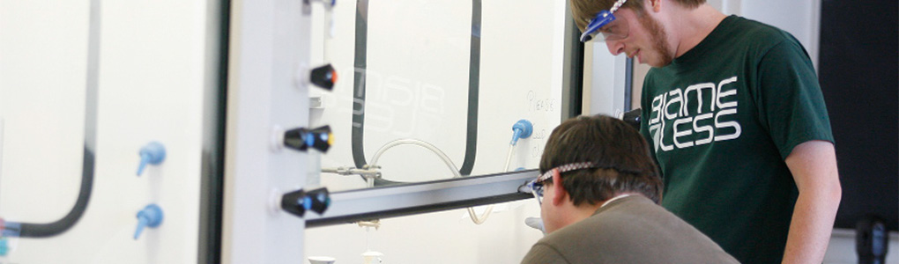
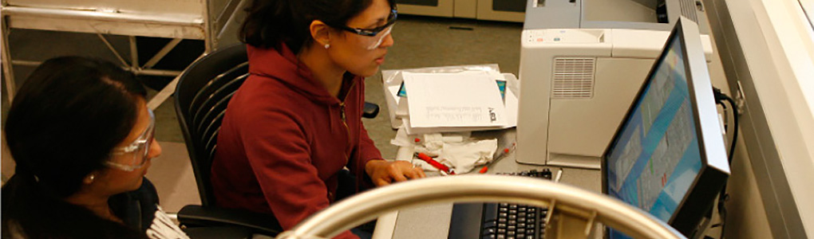
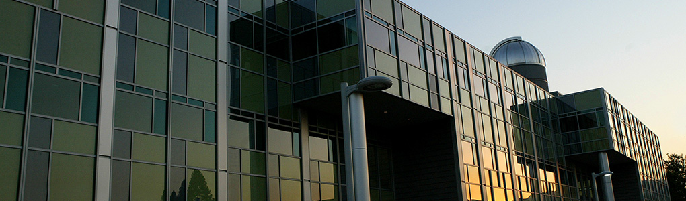
College of Science
Department & Program
AMP (Alliance for Minority Participation)
Biological Sciences
Central Valley Math & Science Alliance
Chemistry
Child Development
Computer Science
Cognitive Studies
Geology
Mathematics
Nursing
Physics & Physical Sciences
Psychology

Slide 17
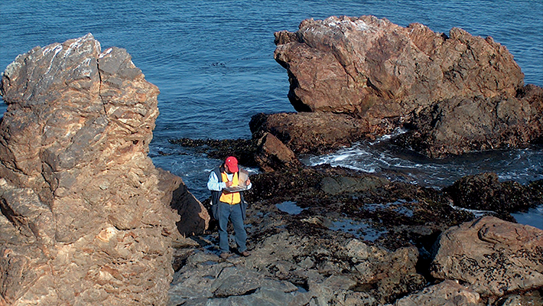


College of Science
Geology
Learn
Classify, identify and interpret geologic materials (rocks, minerals, and fossils)
Reconstruct the geologic history of an area
Determine the direction of flow, availability and quality of groundwater resources
Develop a deep understanding of volcanoes and earthquakes
Career
Environmental geology
Hydrogeology and development of water resources
Engineering geology and seismic engineering
Petroleum geology
Mineral exploration
Environmental law
Research and education

Slide 18


College of Science
Chemistry
Student Leadership Awards
The Warriors Chemistry Club was recognized with the "Student Empowerment Award" and "Outstanding Student Leader of the Year Award".
The Department of Chemistry offers programs of study for students seeking the Bachelor of Arts or the Bachelor of Science in Chemistry. Students may also elect to complete a concentration in Environmental Sciences or a Teaching Credential as part of their degree program. Students should consult with their department adviser to determine which degree and program is best suited to their career objectives.
The Chemistry Department is well equipped with modern instrumentation and facilities.

Slide 19

Department of English
Learn
Communication skills that emphasize critical thinking
A broad knowledge of literature
The ability to interpret culturally diverse literary, non-literary, and visual texts
Bachelor of Arts in English with available concentrations in TESOL and Single Subject Matter Preparation
Career
Writer, reporter or editor
Teacher or researcher
Lawyer
Marketing and public relations
Publishing
Communications specialist
Consulting, librarian
Telecommunications, business and banking

Slide 20


English Proficiency requirements
TOEFL PBT: 500 with part scores of 50
TOEFL iBT: 61 with part scores of 15
IELTS: 6.0 with part scores of 6.0
Students can receive an exemption for submitting TOELF/IELTS scores by submitting one of the following:
Official admission test score report (ACT or SAT I)
Transfer students who have taken an English Composition course at U.S. Higher Education Institution with a grade of B or higher.
Attended a U.S. high school for 3 years.

Slide 21






Student Lifecycle
Apply online
Student applies and submits all necessarydocuments and receives decision from the school.
Upon Acceptance
Student receives an acceptance packet which includes: Acceptance Letter, I-20, Housing Application and instructions regarding arrival.
Apply for a Student Visa
Student takes I-20 and other required documents to a U.S. Embassy or Consulate to apply for a student visa.
Arrive in the United States Student arrives and attends the mandatory university orientation.
Earn U.S. University Degree
Student attends every fall and spring in order to complete their degree.
Explore Post-Graduation
Opportunities Student has the option to transfer schools, start a new degree, apply for post-completion Optional Practical Training (OPT) or depart from the United States.

Slide 22
Student Arrival Process
Student sends in their arrival information worksheet to Office of International Education.
Student arrives at San Francisco, San Jose, Oakland or Sacramento airports and commute to California State University, Stanislaus in Turlock, CA.
Student attends the Mandatory Orientation (the Thursday before classes start). During Orientation, we cover:
  Campus Tour
  Class schedules
  Students who need to take the English Placement Test and/or the Entry Level Math Test will be taken to the Testing Center to schedule and register for the necessary tests.
  Introductions to the various services we offer on campus.
  Immigration rules and office policies
The day after orientation, the students sit for the English Placement Test and/or the Entry Level Math Test.
Classes begin on the Wednesday or Thursday after orientation. Terms typically start the third week of January (for Spring) or August (for Fall).

Slide 23
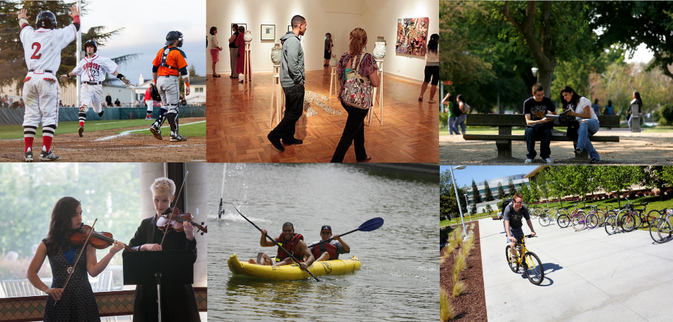
Student Life

Slide 24
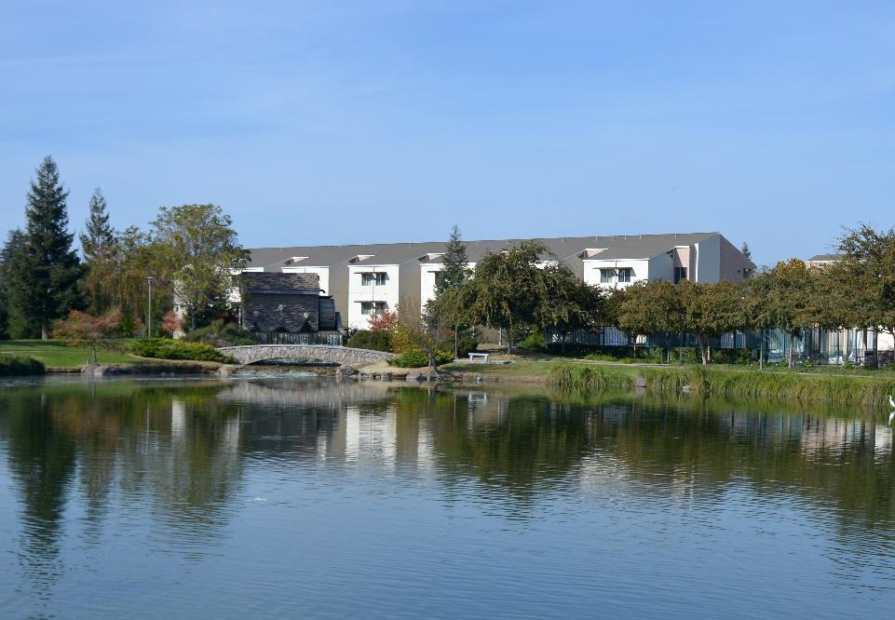
California living on campus
Fitness & Sports Center
Free Laundry Facility
Two Pools & Spa
Dining Facilities
Co-ed Intermural Sports
WiFi Internet
Computer Lab
Academic/ Career Counselors
Outdoor Recreation: Basketball, Volleyball
Courtesy Room Cleaning

Slide 25
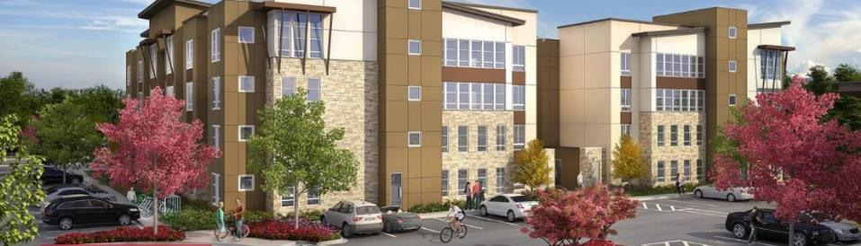
Off-campus Housing
You can live in Turlock for more than half the price of housing in the Bay Area.
Avg. rental rate for Turlock: $770
Avg. rental rate for San Francisco: $3,809
Avg. rental rate for Sacramento: $1,189
Avg. rental rate for Los Angeles rental: $2,625
(For reference only)

Slide 26
Estimated Fees & Costs for One Academic Year
 | American Language Culture Program | Undergraduate | Graduate | Graduate MBA
 |  | (24 units minimum) | (18 units minimum) | (18 units minimum)
Tuitions & Fees | $8,980 | $16,008 | $15,162 | $20,166
Books/Course Materials | $700 | $1,780 | $1,780 | $1,780
Room & Meals | $9,508 | $9,508 | $9,508 | $9,508
Health Insurance | $1,605 | $1,605 | $1,605 | $1,605
Total Expenses | $20,793 | $28,901 | $28,055 | $33,059

Slide 27
Admissions Requirements
Admission Type | Documents Required | Application Deadlines
American Language Culture Program | ALCP Application ALCP Application Fee Unofficial English Proficiency Score Report | Spring: December 15 Fall: July 15
Conditional Admission | ALCP Application ALCP Application Fee CSU Mentor Application Application Fee Original Academic Credentials Official English Proficiency Score Report | Spring: November 1 Fall: May 31
Undergraduate Admission | CSU Mentor Application Application Fee Original Academic Credentials Official English Proficiency Score Report | Spring: November 1 Fall: May 31
Graduate Admission | CSU Mentor Application Application Fee Original Academic Credentials Supplemental Application **Specific documents may be required by some programs. Contact Program Advisor. | Spring: November 1 ** Fall: May 31 ** **Unless otherwise indicated by a specific program.

Slide 28
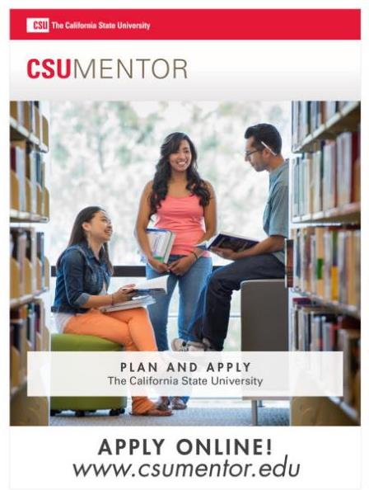

Slide 29
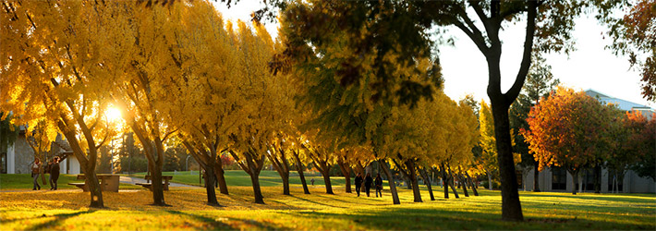
Contact Information
Office of International Education (OIE)
California State University, Stanislaus
One University Circle
Turlock, CA 95382-3200 USA
Tel (+1) 209-667-3117
Fax (+1) 209-667-3791
intlstudent@csustan.edu
Websites
University's Home Page: csustan.edu/students
Office of International Education Home Page: csustan.edu/oie
/stanstateinternational
@stanstateinternational

